Slide 1



Analysis of song lyrics using NLP and Toxicity analysis models
By: Ofek Biton & Shahaf Malka
As part of a course on advanced topics in machine learning
Lecturer: Chen Hajj

Slide 2
Table of Contents
Motivation – project motivation & Problem description
Data Structure and Features
Preprocessing
Methodology
Results
Conclusion

Slide 3

Motivation: project motivation & Problem description
Music is a significant part of everyday life.
Major factor in influencing mood.
Children and teenagers are big consumers of music - consuming music that has negative effects can damage the children's everyday vocabulary and affect their worldview.

Slide 4

Pulling Data & limitations associated
Pulling the Data- interfaced with Spotify's API, an Application Programming Interface, to access their extensive music database.
Finally, export the file to Excel.
limitations associated-
authentication credentials—Client ID and Client Secret.
Handling Spotify's rate - to prevent abuse and ensure service reliability.

Slide 5
Data Structure and Features
Name of the Song - the title of the track, string.
Album Type - the album type as a string, values include 'Single', 'Album', or 'Compilation’.
Artist Name - the name of the artist or band performing the song, string.
Album - the name of the album to which the song belongs, string.
Year - the release year of the song, int.
Length - the duration of the song in milliseconds.
Spotify ID - The unique identifier for each song, object.
Popularity - An integer scoring the song's popularity.
Playlist ID - unique identifier for playlists in which the song appears, object.
Lyrics: The full lyrics of the song , string.

Slide 6
Preprocessing
Data Cleaning - ensuring the data was free from inconsistencies or any irrelevant information. involved - removing any duplicate records, correcting any aberrant data entries, and handling missing values.
Text Processing - tokenization to break down the text into individual words or phrases, removed common stop words, applied stemming or lemmatization to reduce words to their root forms.

Slide 7
Methodology VADER Sentiment Analysis Model
VADER is a lexicon and rule-based sentiment analysis tool specifically attuned to sentiments expressed in social media.
VADER uses a combination of a sentiment lexicon—a list of lexical features which labeled according to their semantic orientation as either positive or negative.
The model is unique because it is sensitive to both the polarity and the intensity of emotions.
assigns each piece of text a compound score that ranges from -1 (most negative) to +1 (most positive), as well as categorical scores that classify the sentiment as either positive, negative, or neutral.

Slide 8
Methodology Detoxify Toxicity Classification Model
originated from machine learning models trained on large datasets with human-annotated examples of toxic behavior.
Through this training - can predict text toxicity, identifying various forms of negative interactions, including insults, threats, and hate speech by understanding textual patterns and context that typically suggest offensive content.
The model represents text using numerical vectors, runs these vectors through a neural network to assess how closely they match with learned patterns of toxic speech.
Based on this evaluation, Detoxify assigns a probability score indicating the likelihood that a given text is toxic.

Slide 9
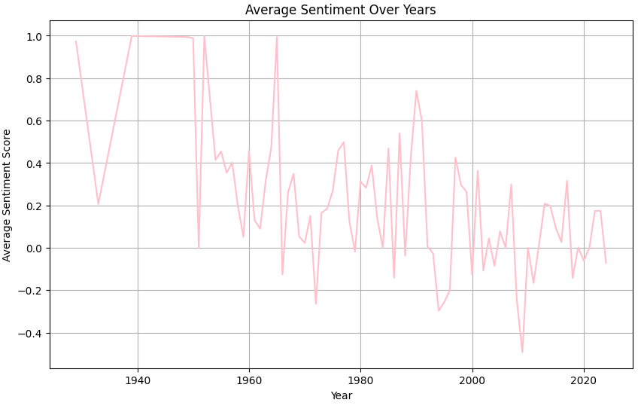
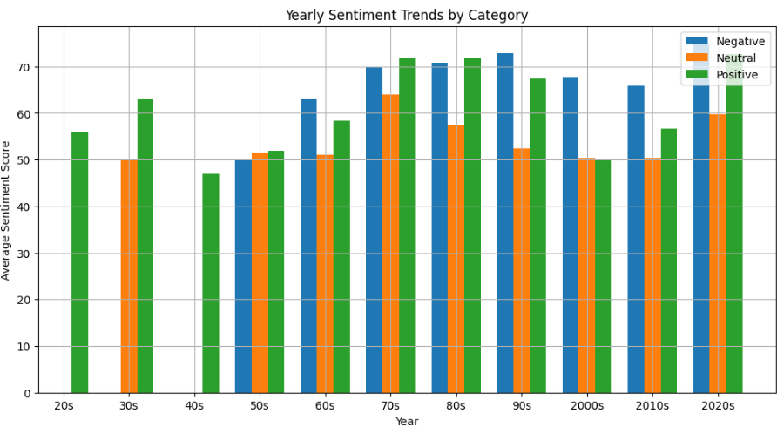
Results
The decrease in the sentiment score of the songs from the 20s until - possibly reflecting societal changes or cultural influences during that time.
correlation between sentiment category and song popularity. Songs categorized as having a positive sentiment tended to be more popular, while those with negative sentiments were less popular on average.

Slide 10
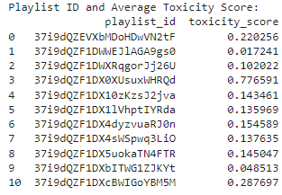
Results
By examining the proportion of offensive songs in each playlist, we were able to identify playlists that may not be suitable for certain audiences, such as those under 18 years old.
In addition, you can use the average toxicity score of each playlist to determine what the toxicity threshold is that we want to consume and thus choose the playlists we want to listen to.
Prohibited Playlists for Under 18

Slide 11
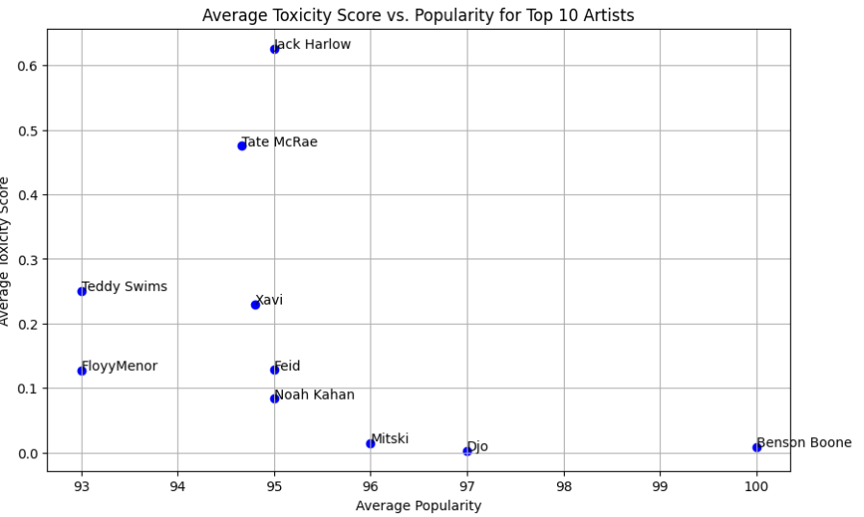
Results
8 out of 10 singers are below a toxicity score of 0.3.
strong correlation between artist messaging and audience values -potentially reflecting a broader societal shift towards more uplifting and socially conscious music consumption patterns.
Such alignment likely enhances the appeal and resonance of these artists' work, contributing substantially to their widespread recognition and success.

Slide 12
conclusions
These findings have implications for content curation and recommendation algorithms in music streaming platforms.
By considering sentiment analysis and offensive language detection, platforms can better tailor music recommendations to individual preferences and sensitivities.
Follow-up research:
expand the analysis to include a larger dataset spanning more genres, languages, and time periods.
refining the sentiment analysis and offensive language detection models could lead to more accurate insights and recommendations.

Slide 13


